Slide 1
Census vs Sampling
Census Overview: Gathers information about every member of a group – called a population. survey of an entire population Advantages: Reflects the entire population Disadvantages: Takes longer to collect data than a sample More expansive than a sample | Sampling Overview: survey that examines only a portion of the population Data which can be measured. Advantages: Cheaper than census Quicker than census Uses less resources Disadvantages: Can have sampling bias May not reflect population

Slide 2
Qualitative vs Quantitative Data
Qualitative (Categorical) Data Overview: Deals with descriptions. Data can be observed but not measured. Colors, textures, smells, tastes, appearance, beauty, etc. Qualitative → Quality | Quantitative (Numerical) Data Overview: Deals with numbers. Data which can be measured. Length, height, area, volume, weight, speed, time, temperature, humidity, sound levels, cost, members, ages, etc. Quantitative → Quantity

Slide 3
Example 1: Oil Painting Qualitative data: *red/green color, gold frame *smells old and musty *texture shows brush strokes of oil paint *peaceful scene of the country *masterful brush strokes | Example 1: Oil Painting Quantitative data: *picture is 10" by 14” with frame 14" by 18” * weighs 8.5 pounds surface area of painting is 140 sq. in. *cost $300

Slide 4

Example 2: Latte Qualitative data: *robust aroma *frothy appearance * strong taste *glass cup | Example 2: Latte Quantitative data: *12 ounces of latte *serving temperature 150⁰ F. *serving cup 7 inches in height *cost $4.95

Slide 5

Example 3: Freshman Class Qualitative data: *friendly demeanors *civic minded *environmentalists *positive school spirit | Example 3: Freshman Class Quantitative data: *672 students *394 girls, 278 boys *68% on honor roll *150 students accelerated in mathematics

Slide 6
Types of Quantitative Data
Discrete: Reflects a number obtained by counting—no decimal.
Eg: number of siblings, number of students in the class
Continuous: Reflects a measurement; the number
of decimal places depends on the precision of the measuring device.
E.g. persons height, time in a race.

Slide 7
Frequency Tables
Statistics deals with collecting, organizing, and interpreting data. Data are pieces of information, which are often numerical. Large amounts of data can be organized in a frequency table. A frequency table tells the number of times an event, category, or group occurs

Slide 8
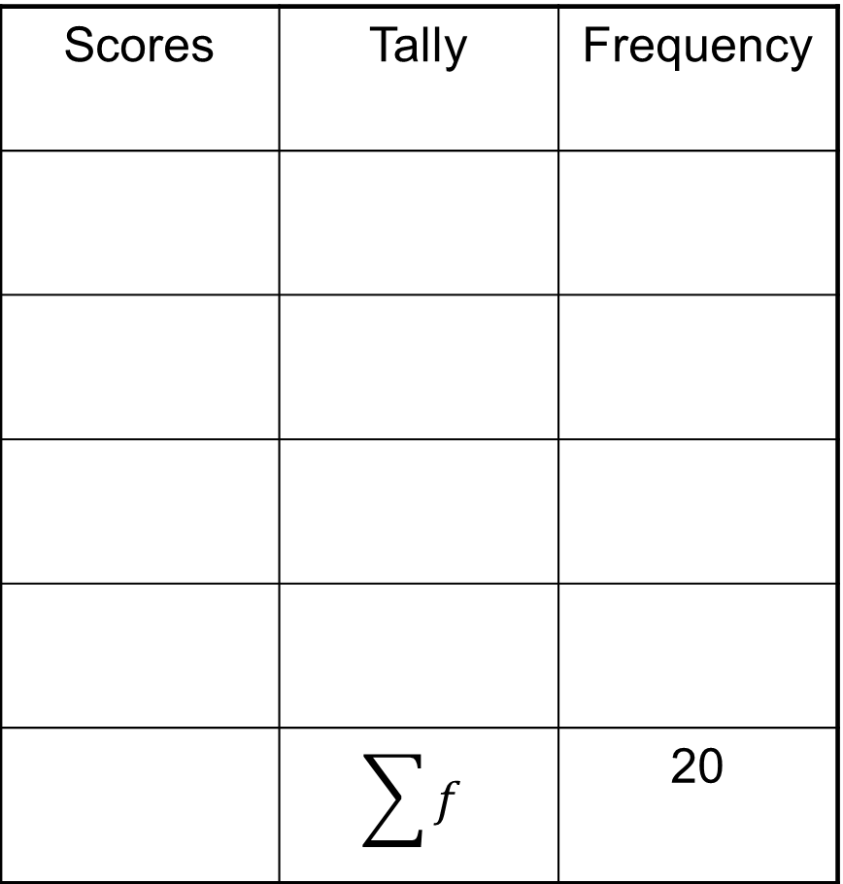
Example
Scores | Tally | Frequency
 | $$\sum{f}$$ | 20
Winning Score
1 2 1 4
3 3 2 4
3 2 3 2
1 2 4 3
4 3 3 2
1
3
2
6
3
7
4
4

Slide 9
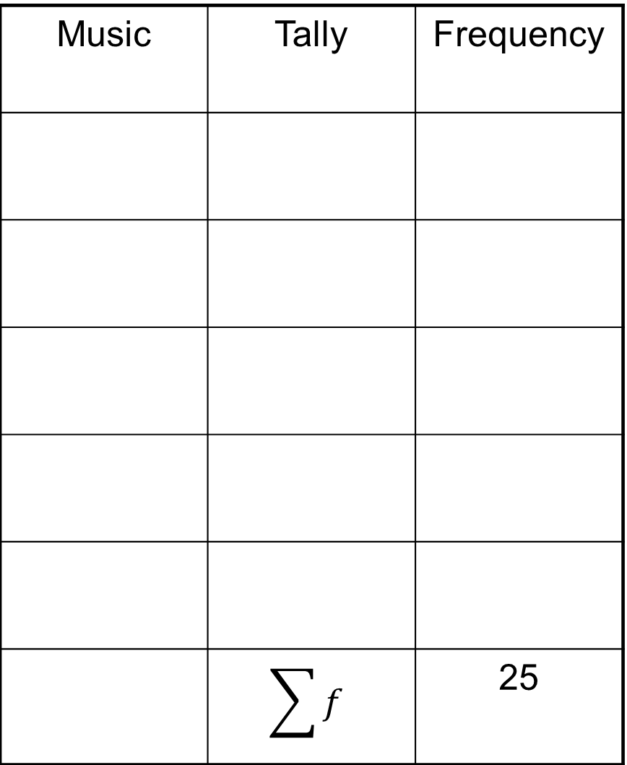
Example
Music | Tally | Frequency
 | $$\sum{f}$$ | 25
Favorite Music
P R F P F
F R F P P
F P F C P
C J R R F
J R P P F
R= rock J= jazz
C= country P= rap
F= top 40
Rock
5
Jazz
2
Country
2
Top 40
8
Rap
8

Slide 10
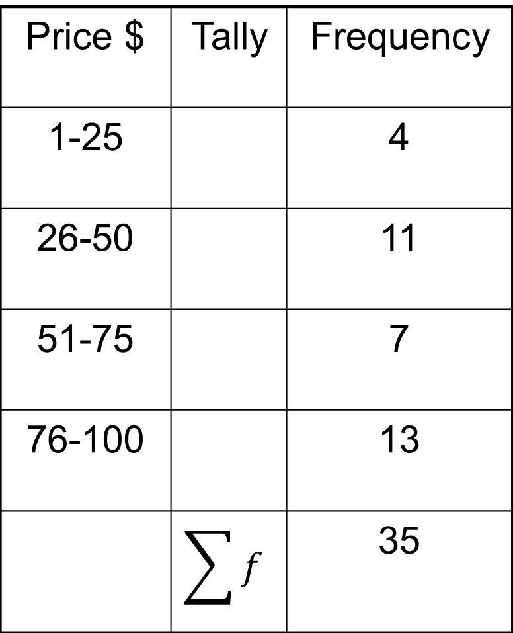
Frequency Tables - Words to Know
Shows the number of pieces of data that fall within given intervals.
Price $ | Tally | Frequency
1-25 |  | 4
26-50 |  | 11
51-75 |  | 7
76-100 |  | 13
 | $$\sum{f}$$ | 35
Scale- includes the least value and greatest value
Interval- Separates the scale into equal parts

